Slide 1
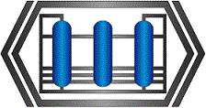
Modern isomerization and
reforming technologies
for enhancement of quality and yield of Euro-5 compliant motor gasoline
Timofey Karpenko
Chief Technology Officer
SIE Neftehim

Slide 2
Technology of SIE NEFTEHIM
Technology/Catalyst
Isomerization C4
I-butane
Catalyst
Isomerization C5-C6
Naphtha
Naphtha
Hydrotreating
Isomerization C7
Commercial
gasoline
Reforming SRR
Reforming CCR
Atmospheric
Distillation
Xylene Isomerization
P-xylene
Diesel
Diesel
Hydrotreating
Hydrogen gas Methanation
H₂ gas
Scientific Industrial Enterprise Neftehim

Slide 3
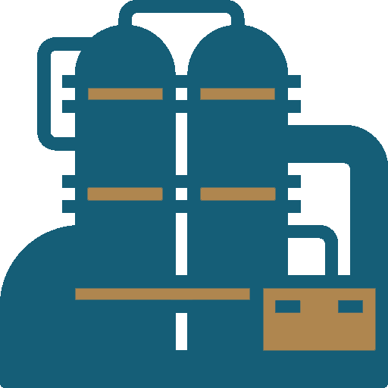
REF series catalysts for
fixed bed reforming units
REF-125
REF-130
17
Catalysts
operating experience
units
RON boost up to 99
Possible operation at low pressure
Longer service cycle up to 4 years
High stability for severe operation
Possible catalyst replacement
in operating SRR units
Scientific Industrial Enterprise Neftehim

Slide 4
SRR catalysts. Comparative analysis
 | Conventional commercial catalyst | REF^{Ultra} | Benefits
RON | 96-98 | 98-99 | Reformate up to 99 RON
Service cycle, years | 2-3 | 3-4 | High stability = Service cycle - 4 years
Reformate yield, wt. % | 85-89 | 86-90 | Enhanced reformate yield
Hydrogen yield, wt. % | 2.3-2.6 | 2.3-2.7 | High selectivity = enhanced H₂ yield
Scientific Industrial Enterprise Neftehim

Slide 5
Commercial experience of CCR unit conversion to RC catalyst
506
98.6
493
97.5
85.3
86.1
82.2
82.6
Reformate
RON
Reformate yield,
vol. %
H₂ gas purity, vol. %
Temperature,
WAIT, ˚C
Commercial analogue
RC-12
SIE Neftehim
Total catalyst change-out in operating CCR units and existing catalyst make-up
Scientific Industrial Enterprise Neftehim

Slide 6
Pentane-hexane cuts isomerization technology Isomalk-2
More than 15 years of commercial experience
More than 30 references (Russia, USA, EU, China, India, Ukraine, Romania, Middle East countries), more than 1,000,000 hours of total commercial operation of SI-2 catalyst
Maximum efficiency
Isomerate production with more than 93 RON in operating units.
Once-through isomerate PIN 130+
Maximum stability
High catalyst tolerance to catalytic poisons, activity restoration after excursions of water up to 100 ppm and sulfur up to 5 ppm
Actual catalyst service life in operating units is more than 14 years
Maximum ecological safety
No acid reagents and caustic wastes.
No corrosive media within the entire catalyst operating life cycle
Scientific Industrial Enterprise Neftehim

Slide 7
Isomerization unit conversion
from chlorinated catalyst to SI-2 catalyst
Tolerance to catalytic poisons,
expected service life of SI-2 catalyst is more than 10 years
167
140
140
No corrosion and caustic wastes in the unit
135
99.2
99.2
82.2
83.7
83
77
С₅₊ clear RON
Start of run
С₅₊ clear RON
End of run/
current value
Isomerate yield,
vol. %
R-1A inlet
temperature
Start of run
R-1A inlet
temperature
End of run/
current value
Chlorinated catalyst
SI-2 SIE Neftehim
In 2019, SIE Neftehim has completed research and developed
SI-2B catalyst modification for direct change-out of chlorinated catalyst without revamp

Slide 8
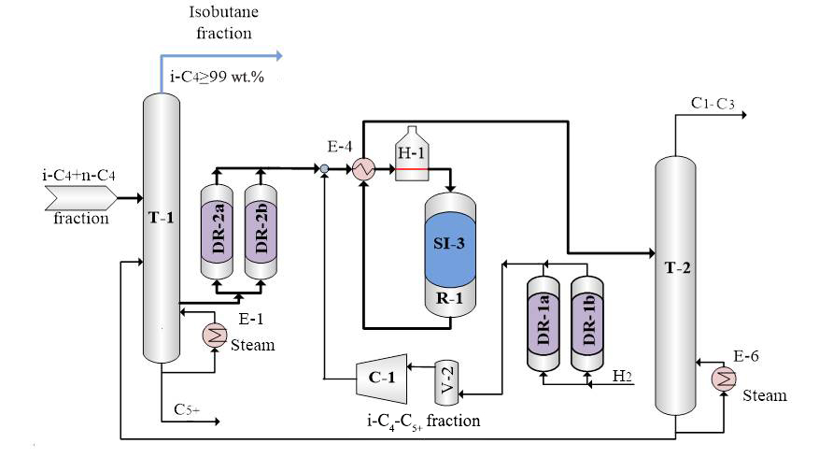
Innovative technology
of n-butane isomerization Isomalk-3
based on oxide catalyst SI-3
2015
2019
2020…
First commercial unit
200 KTA
4 operating
commercial units
Implementation of new projects and catalyst replacement in existing units
Scientific Industrial Enterprise Neftehim

Slide 9
Prospective С₇ hydrocarbons isomerization
technology (70-105˚C cut)
C₇ hydrocarbons processing
Isomerization
Reforming
Isomalk-4
Distribution of 70-105°С cut between these two units reduces their operating performances
Selectivity 95%
Yield 93-95%
RON 85-87
Low conversion
Low aromatization
level
Oxide
Catalyst SI-4
High cracking
High cracking
Scientific Industrial Enterprise Neftehim

Slide 10
Prospective configuration of Euro-5
motor gasoline production
IBP-70˚C
С₅-С₆ cut isomerization
_{Yield 98%}
Aromatics 0%
Isomerate
23%
RON 92
22.5%
RON 95
IBP-180˚C
Aromatics 0%
70-105˚C
С₇ cut isomerization
_{Yield 93%}
Aromatics < 35%
Benzene < 1%
Feed
Fractionation
Isomerate
Blending section
10%
RON 85
_{Yield > 88%}
100%
9.3%
Aromatics 60%
Benzene <1.2%
105-180˚C
Reforming
_{Yield 84%}
Reformate
67%
RON 98
56.3%
- Production of additional amount of non-aromatic fuel component
- Enhanced reformate yield in reforming unit
- Reduced benzene content in reformate until 1.0-1.5 wt. % due to reforming feed upgrade
Scientific Industrial Enterprise Neftehim

Slide 11
SIE NEFTEHIM, LLC
Creation and introduction of oil processing technologies – more than 60 years
Catalyst production facilities – up to 900 tons/year
Number of workers – more than 100
We will find the optimum solution for your production
Our contacts:
www.nefthim.com
Address: 4 Zakharov str., 350007 Krasnodar, Russia
Tel/fax: +7 (861) 203-20-20
e-mail: info@nefthim.ru

Slide 12
THANK YOU!
ANY QUESTIONS?

